Slide 1
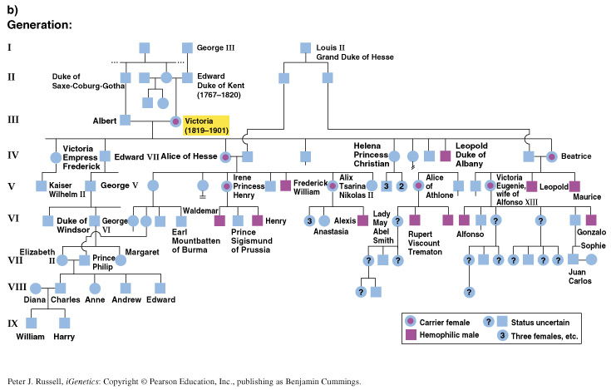

Slide 2
Basic patterns of inheritance
  autosomal, recessive
  autosomal, dominant
  X-linked, recessive
  X-linked, dominant (very rare)

Slide 3

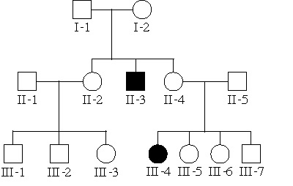
male
female
affected individuals

Slide 4
Autosomal recessive traits
Trait is rare in pedigree
Trait often skips generations (hidden in heterozygous carriers)
Trait affects males and females equally

Slide 5
Autosomal recessive diseases in humans
Most common ones
  Cystic fibrosis
  Sickle cell anemia
  Phenylketonuria (PKU)
  Tay-Sachs disease
For each of these, overdominance (heterozygote superiority) has been suggested as a factor in maintaining the disease alleles at high frequency in some populations

Slide 6
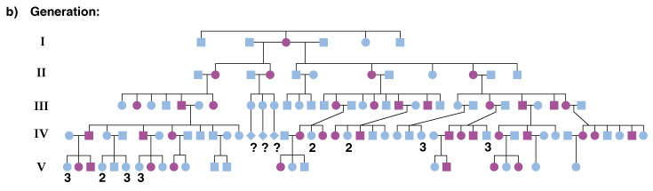
Autosomal dominant pedigrees
Trait is common in the pedigree
Trait is found in every generation
Affected individuals transmit the trait to ~1/2 of their children (regardless of sex)

Slide 7
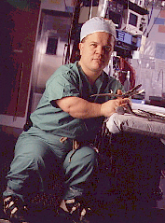
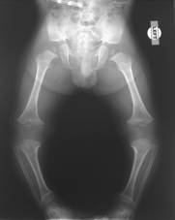
Autosomal dominant traits
There are few autosomal dominant human diseases but some rare traits have this inheritance pattern
ex. achondroplasia (a sketelal disorder causing dwarfism)

Slide 8
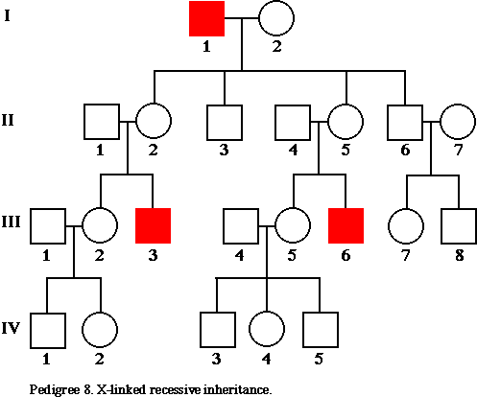
X-linked recessive pedigrees
Trait is rare in pedigree
Trait skips generations
Affected fathers DO NOT pass to their sons,
Males are more often affected than females

Slide 9
X-linked recessive traits
ex. Hemophilia in European royalty

Slide 10
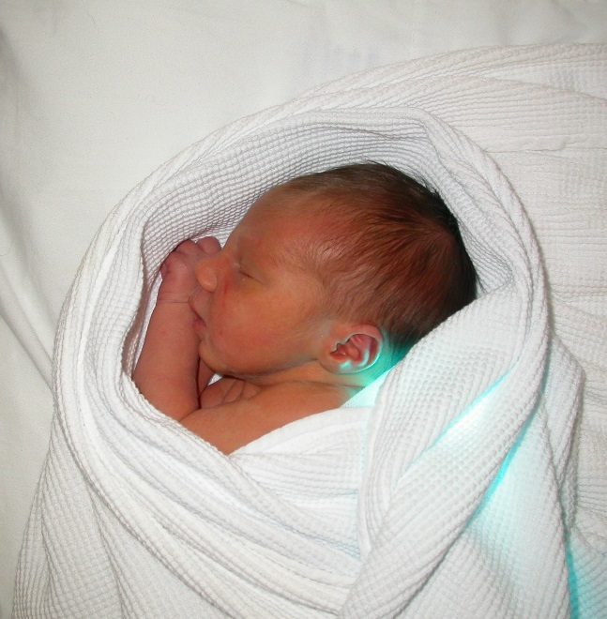
X-linked recessive traits
ex. Glucose-6-Phosphate Dehydrogenase deficiency
hemolytic disorder causes jaundice in infants and (often fatal) sensitivity to fava beans in adults
the most common enzyme disorder worldwide, especially in those of Mediterranean ancestry
may confer malaria resistance

Slide 11
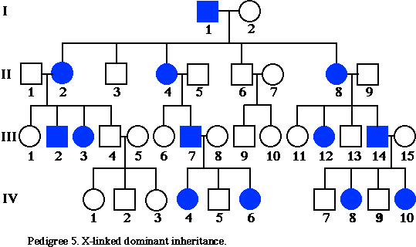
X-linked dominant pedigrees
Trait is common in pedigree
Affected fathers pass to ALL of their daughters
Males and females are equally likely to be affected

Slide 12
X-linked dominant diseases
X-linked dominant diseases are extremely unusual
Often, they are lethal (before birth) in males and only seen in females
ex. incontinentia pigmenti (skin lesions)
ex. X-linked rickets (bone lesions)

Slide 13
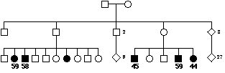
Pedigree Analysis in real life: complications
Incomplete Penetrance of autosomal dominant traits
=> not everyone with genotype expresses trait at all
Ex. Breast cancer genes BRCA-1 and BRCA-2
& many “genetic tendencies” for human diseases

Slide 14
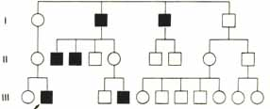
Pedigree Analysis in real life: complications
Sex-limited expression
=> trait only found in males OR females

Slide 15
Pedigree Analysis in real life
  dominant traits may be rare in population
  recessive traits may be common in population
  alleles may come into the pedigree from 2 sources
  mutation happens
  often traits are more complex
      affected by environment & other genes

Slide 16
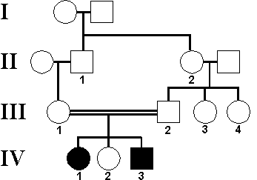
What is the pattern of inheritance?
What are IV-2’s odds of being a carrier?

Slide 17
Sample pedigree - cystic fibrosis
What can we say about I-1 and I-2?
What can we say about II-4 and II-5?
What are the odds that III-5 is a carrier?
What can we say about gene frequency?

Slide 18
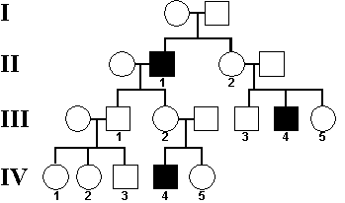
What is the inheritance pattern?
What is the genotype of III-1, III-2, and II-3?
What are the odds that IV-5 would have an affected son?

Slide 19
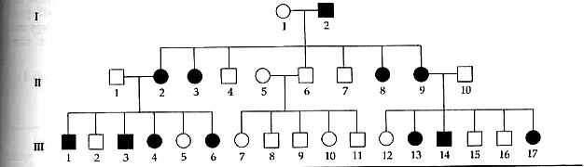
III-1 has 12 kids with an unaffected wife
8 sons - 1 affected
4 daughters - 2 affected
Does he have reason to be concerned about paternity?

Slide 20
Pedigree analysis of the patient with Global developmental defect
Great Grand Father
Great Grand Mother
Grand Mother
Paternal Uncle
Showed similar symptoms during childhood
Father
Mother
Maternal Uncle
Exactly similar symptoms
To the patient
Patient
Elder sister
Showed similar symptoms during child hood
Healthy Younger sister

